Slide 1
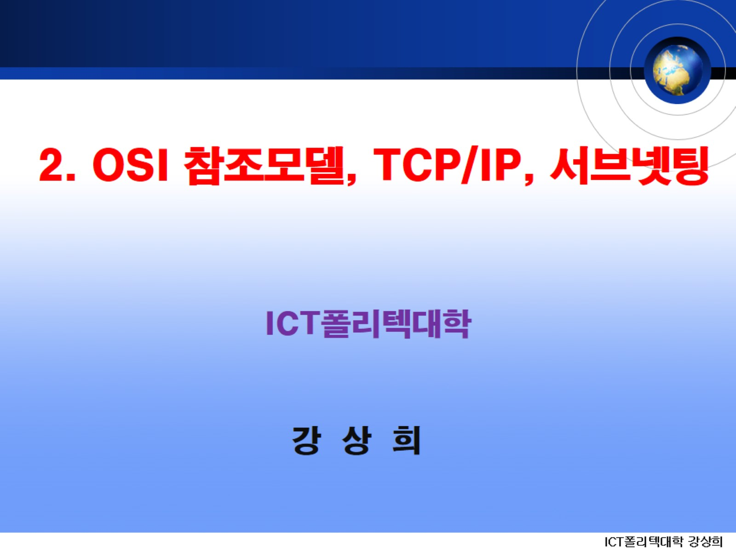
2. OSI 참조모델, TCP/IP, 서브넷팅

Slide 2
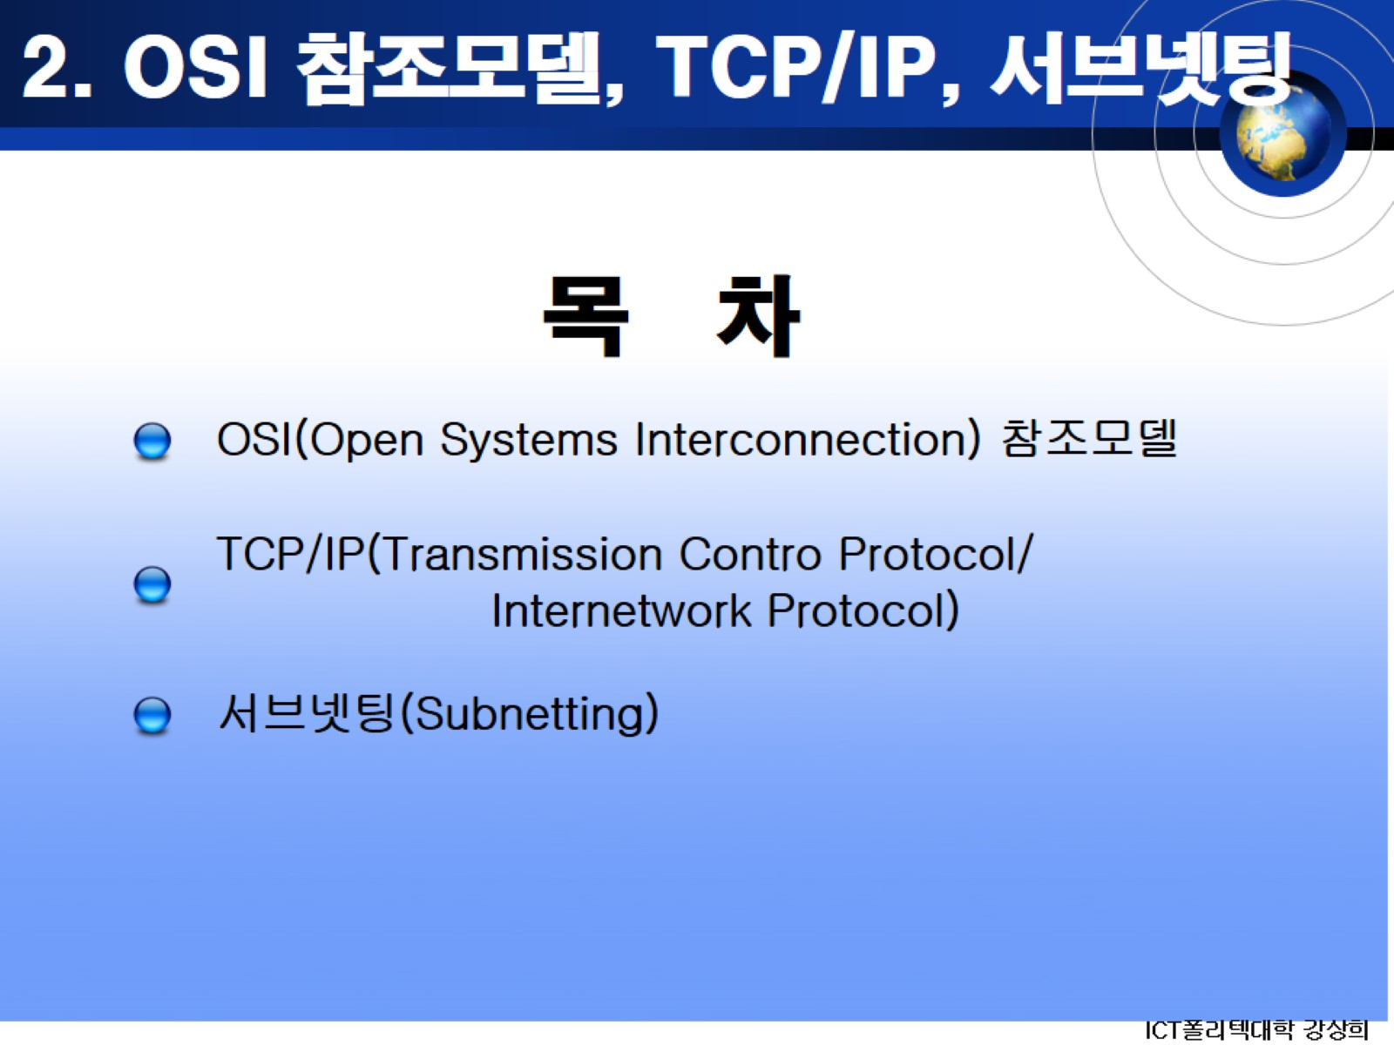
2. OSI 참조모델, TCP/IP, 서브넷팅

Slide 3
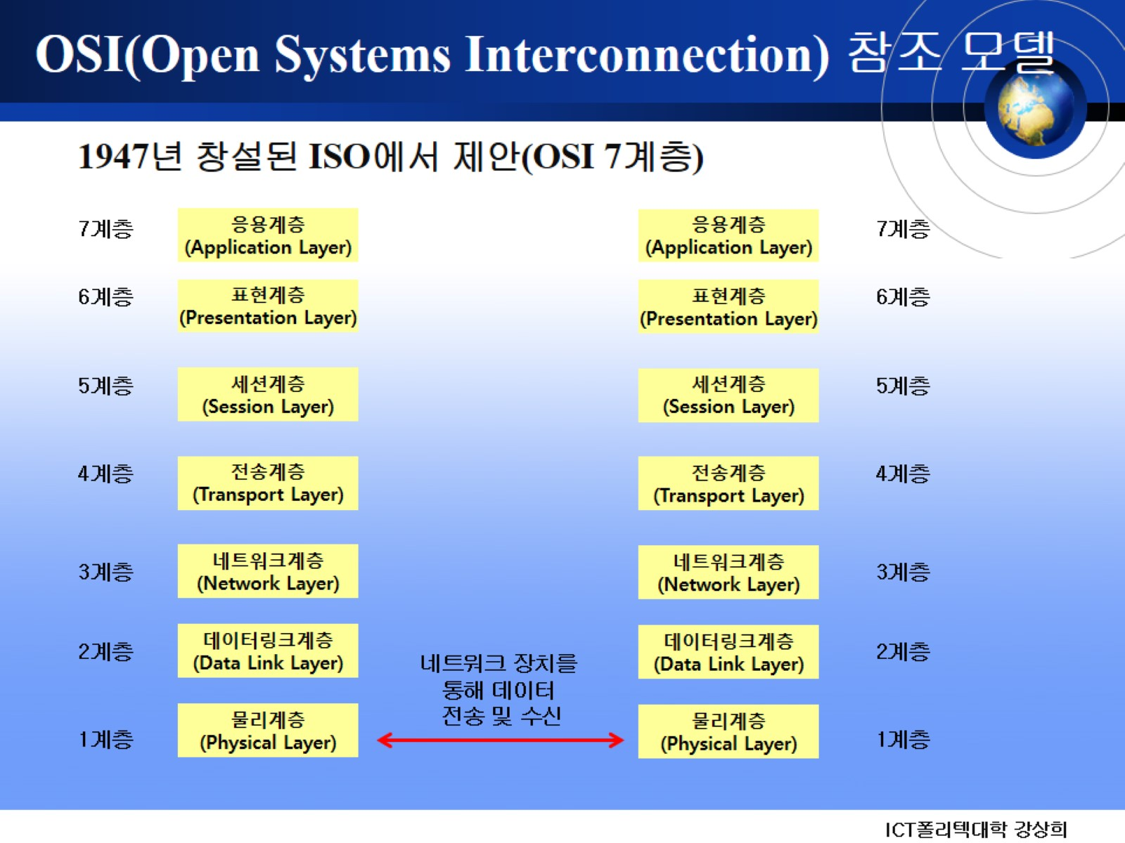
OSI(Open Systems Interconnection) 참조 모델

Slide 4
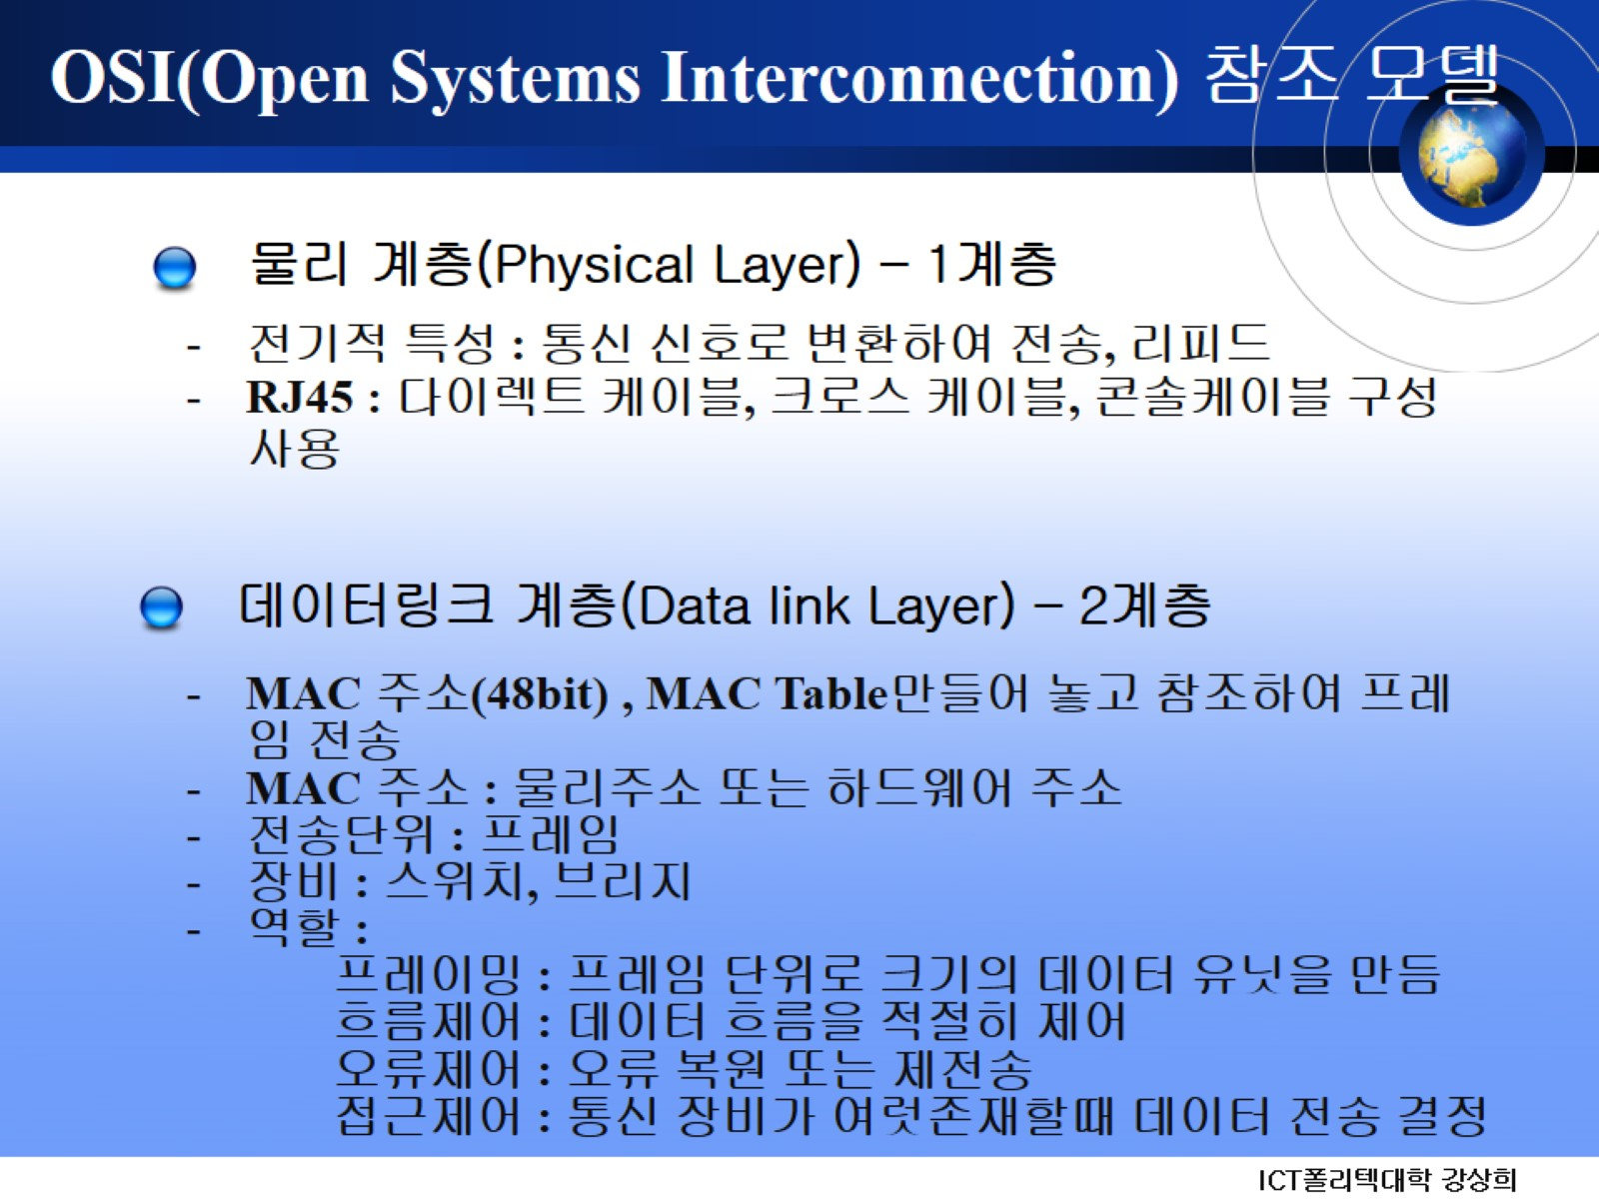
OSI(Open Systems Interconnection) 참조 모델

Slide 5
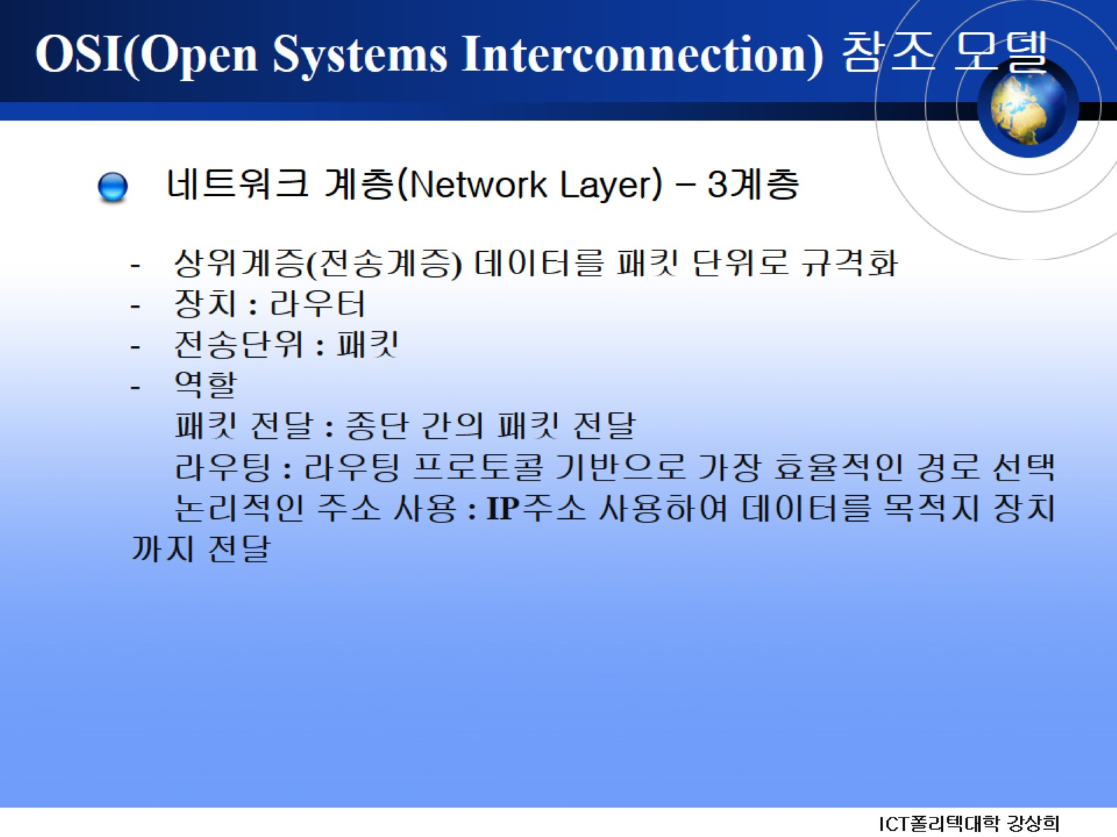
OSI(Open Systems Interconnection) 참조 모델

Slide 6
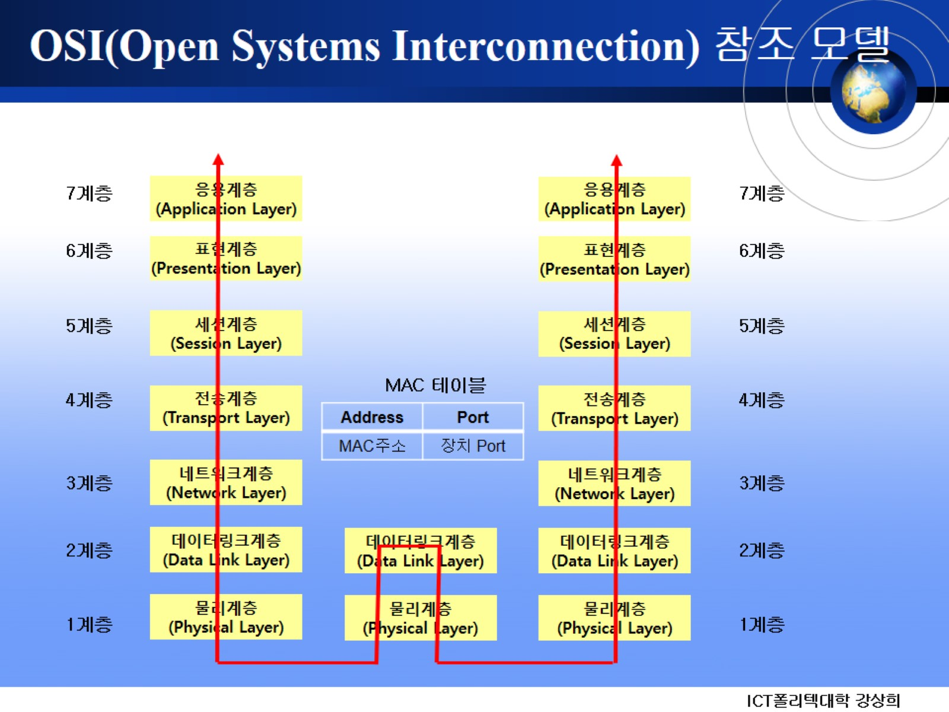
OSI(Open Systems Interconnection) 참조 모델

Slide 7
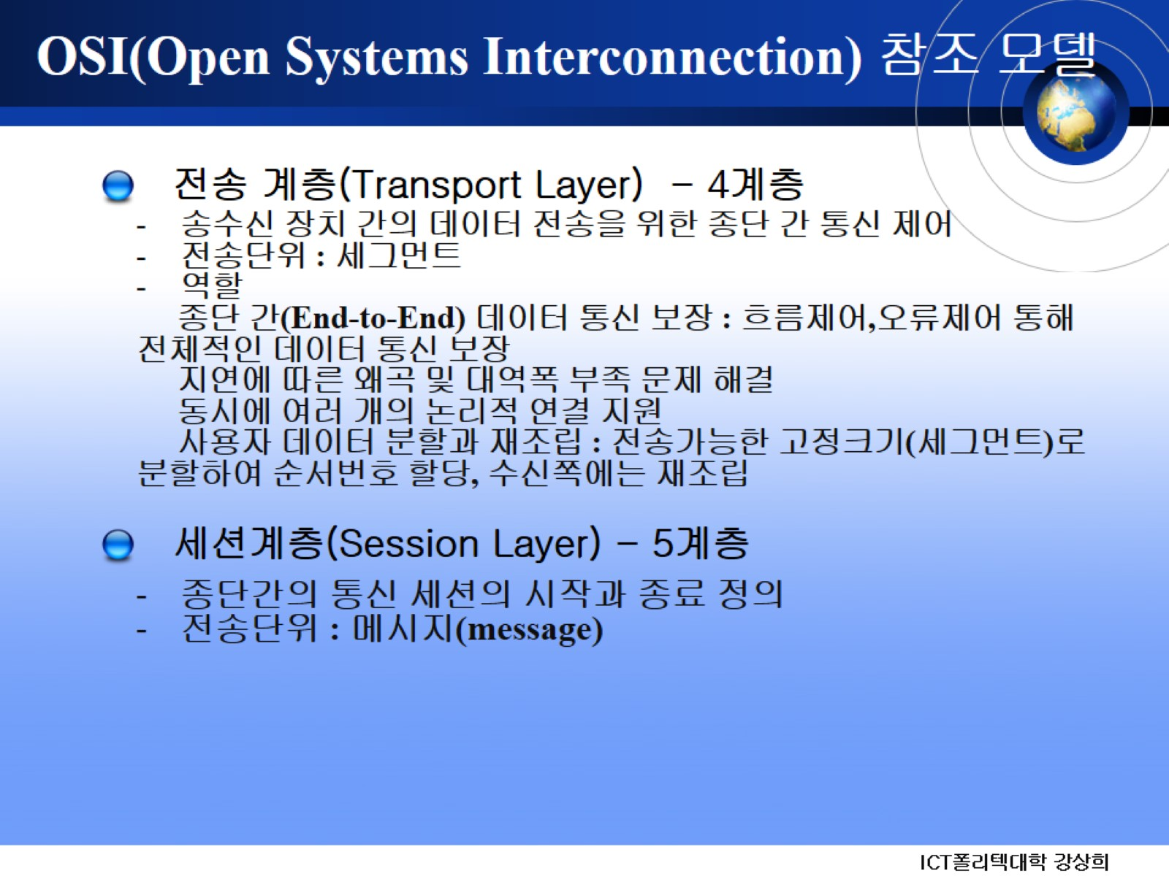
OSI(Open Systems Interconnection) 참조 모델

Slide 8
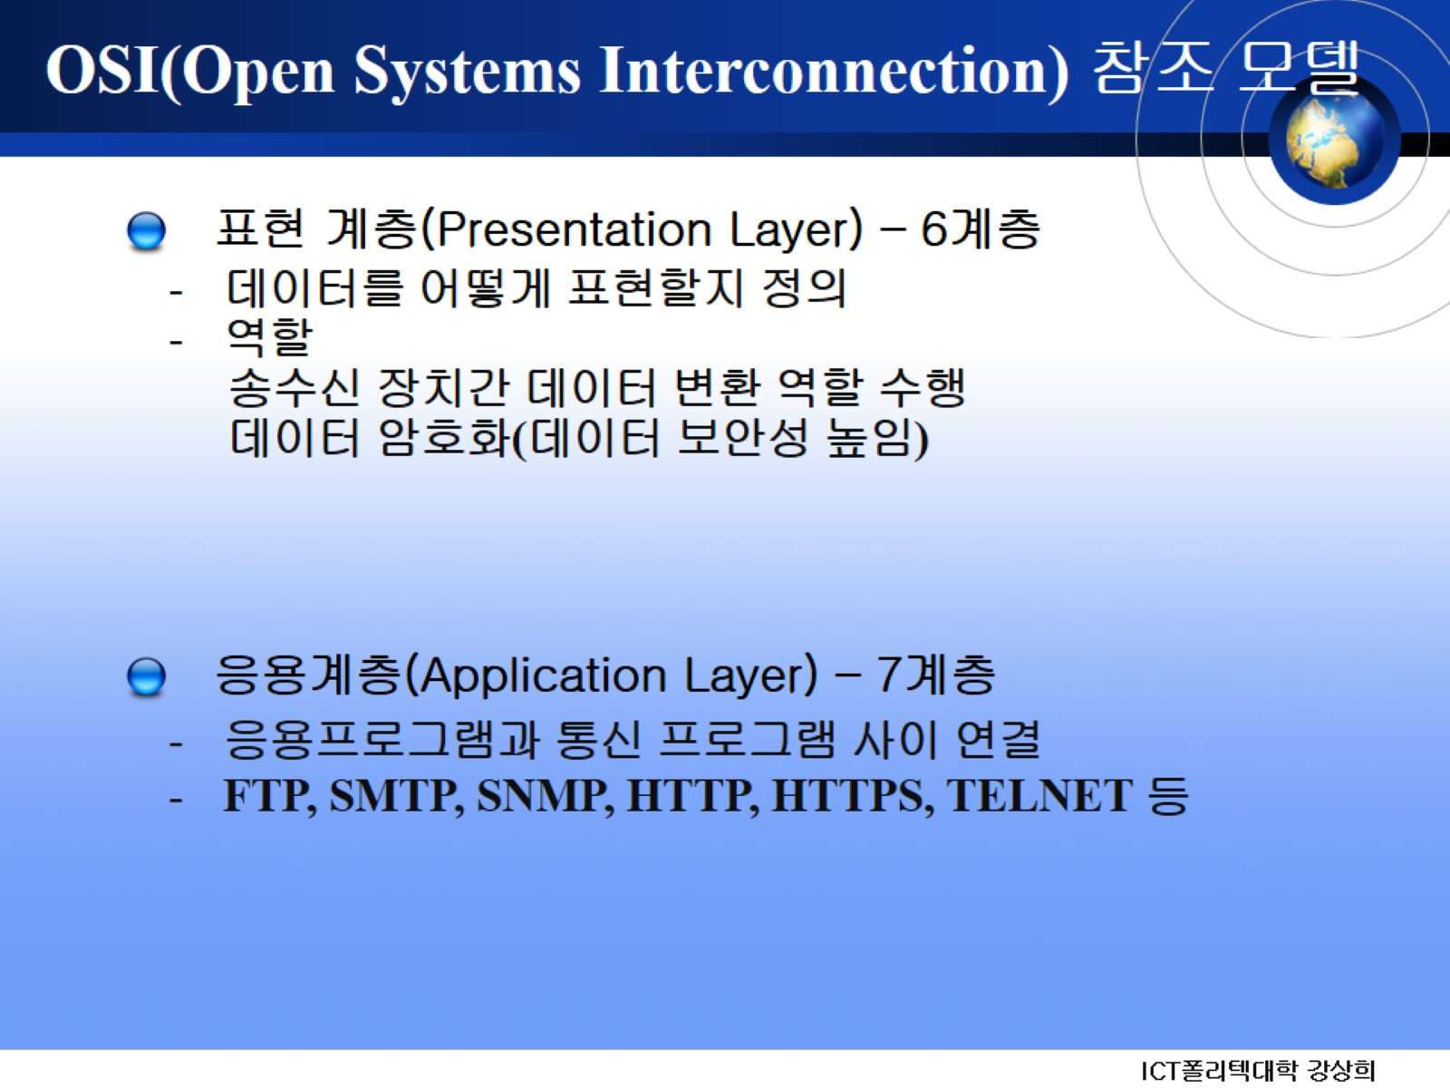
OSI(Open Systems Interconnection) 참조 모델

Slide 9
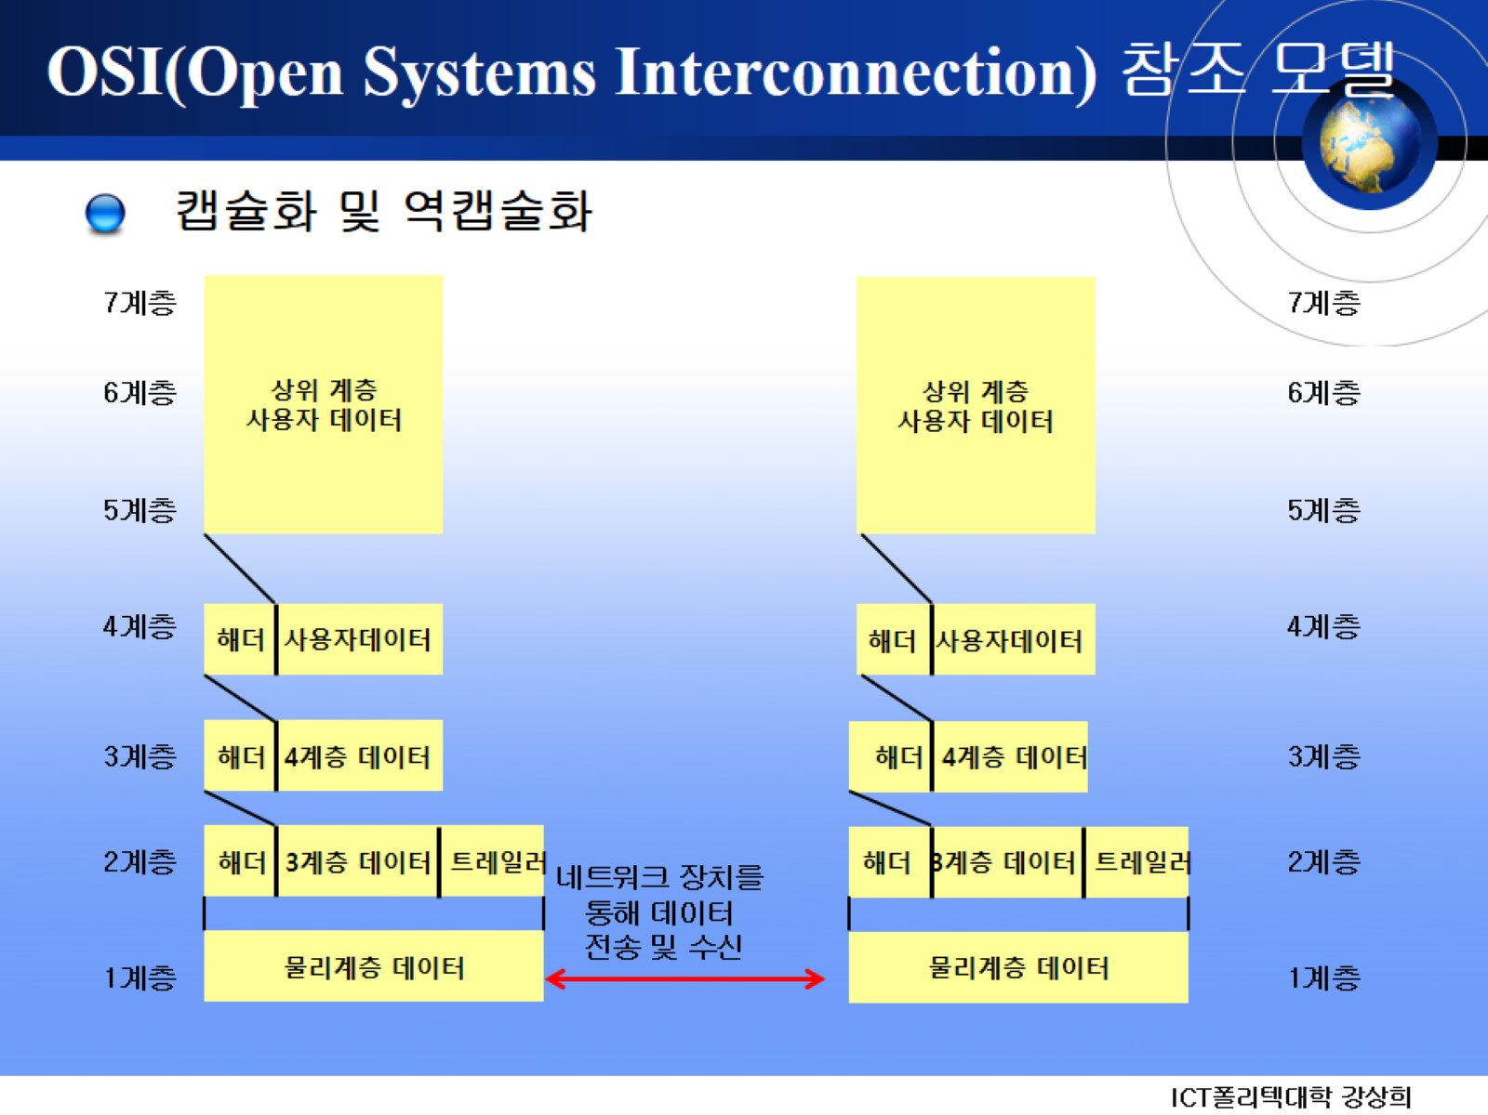
OSI(Open Systems Interconnection) 참조 모델

Slide 10
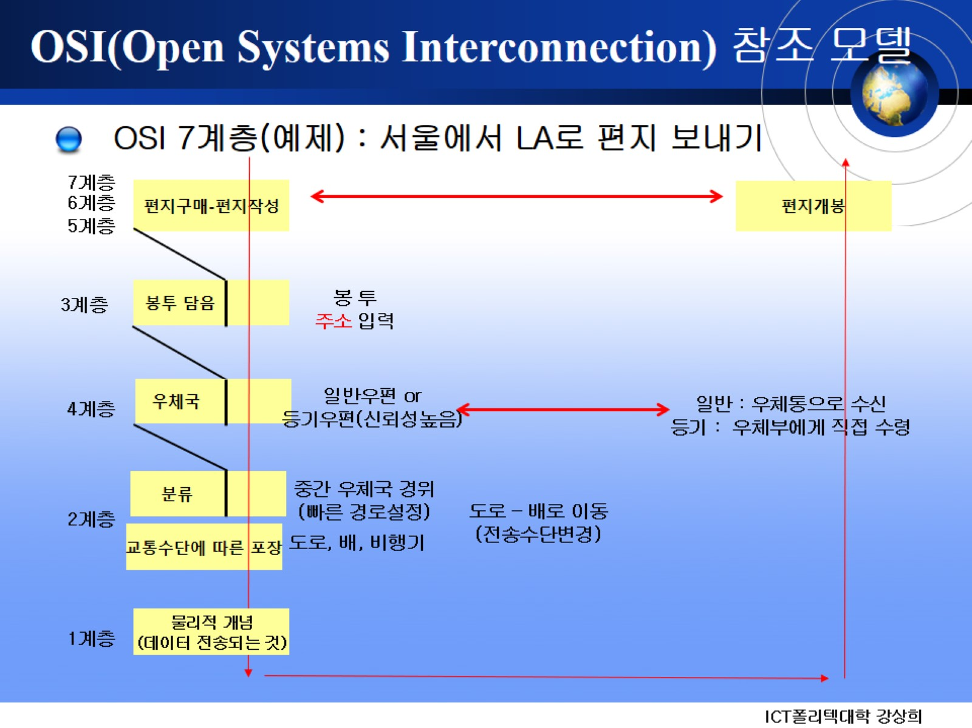
OSI(Open Systems Interconnection) 참조 모델

Slide 11
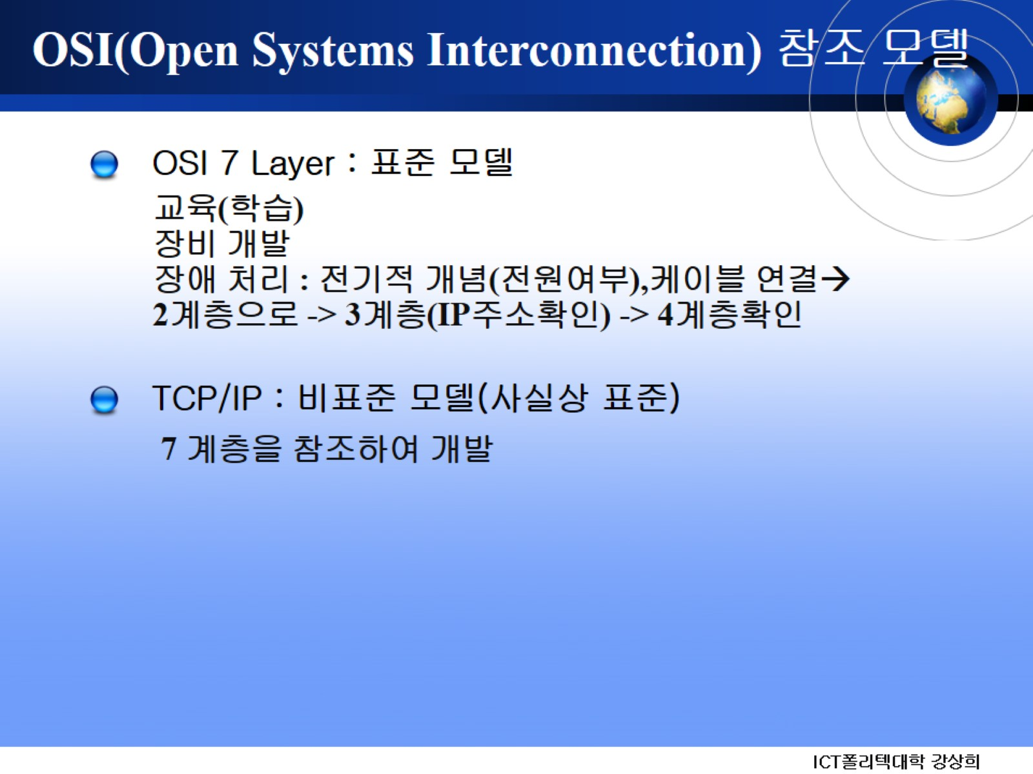
OSI(Open Systems Interconnection) 참조 모델

Slide 12
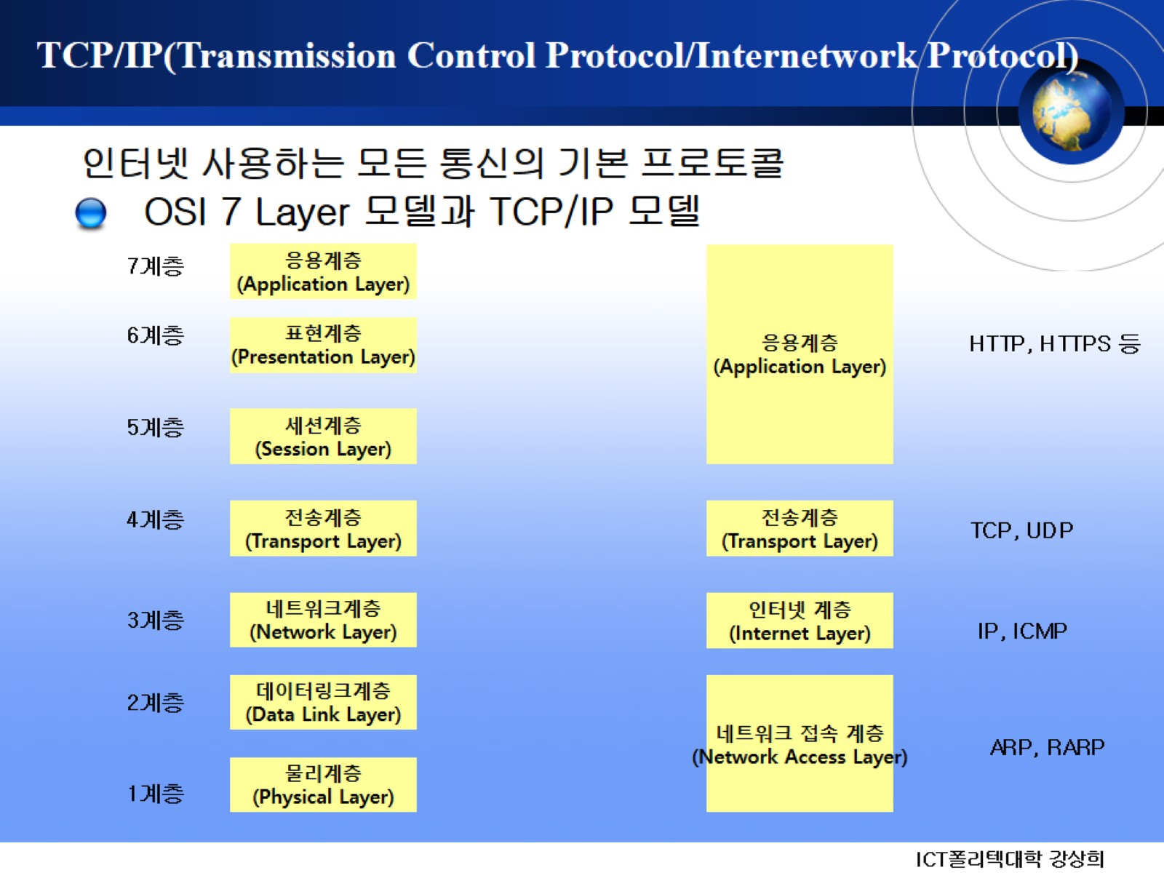
TCP/IP(Transmission Control Protocol/Internetwork Protocol)

Slide 13
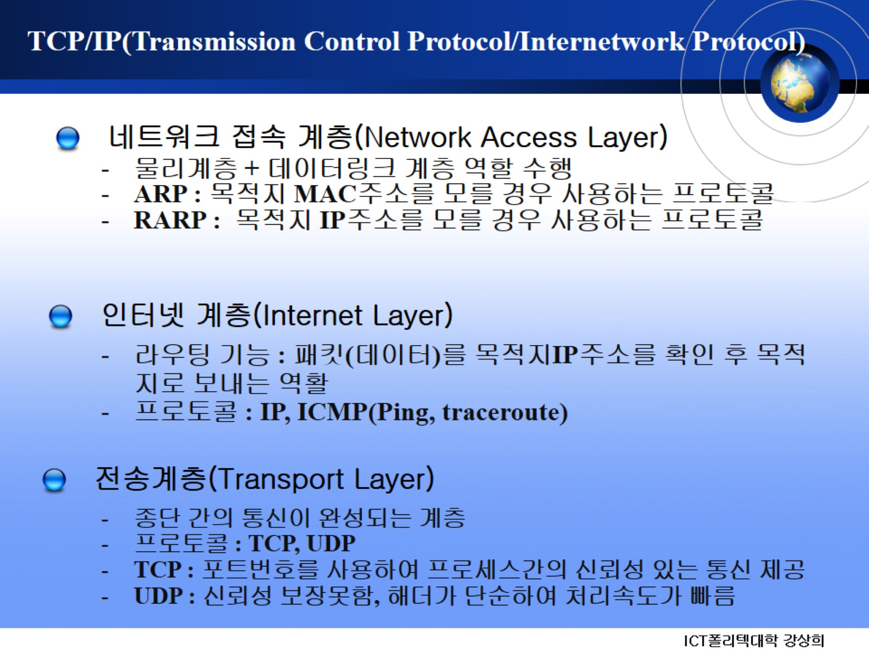
TCP/IP(Transmission Control Protocol/Internetwork Protocol)

Slide 14
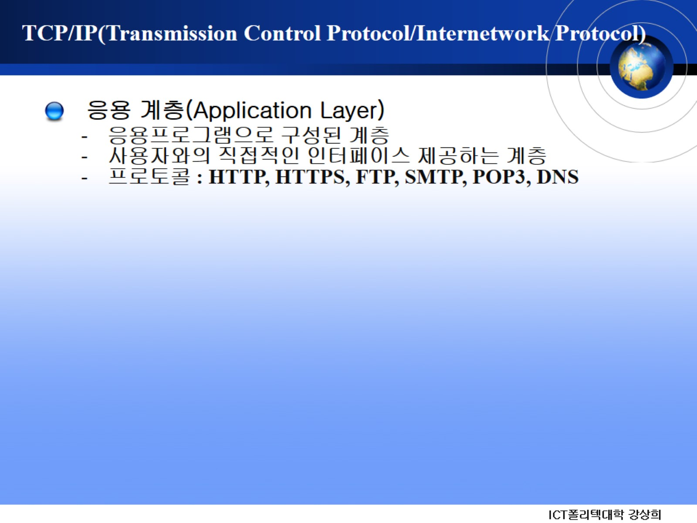
TCP/IP(Transmission Control Protocol/Internetwork Protocol)

Slide 15
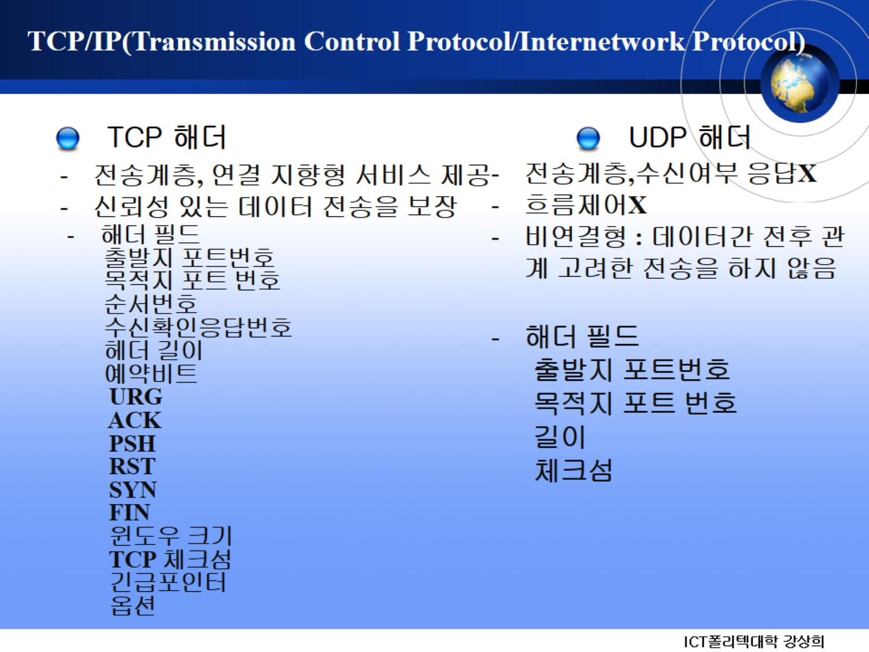
TCP/IP(Transmission Control Protocol/Internetwork Protocol)

Slide 16
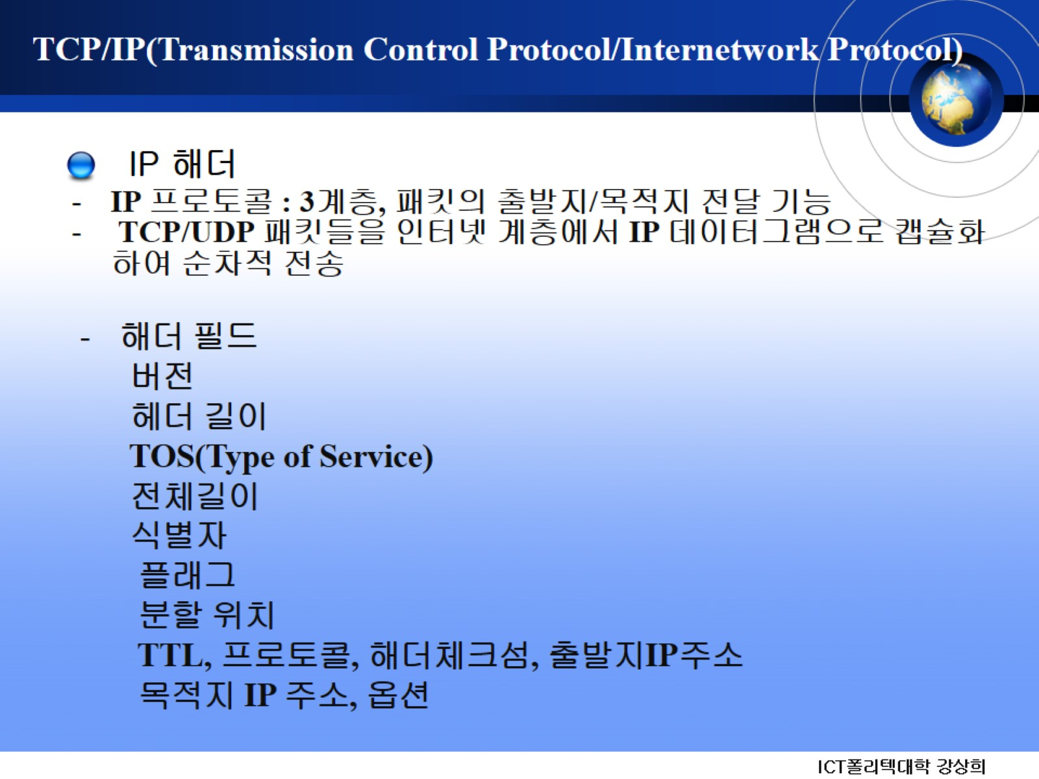
TCP/IP(Transmission Control Protocol/Internetwork Protocol)

Slide 17
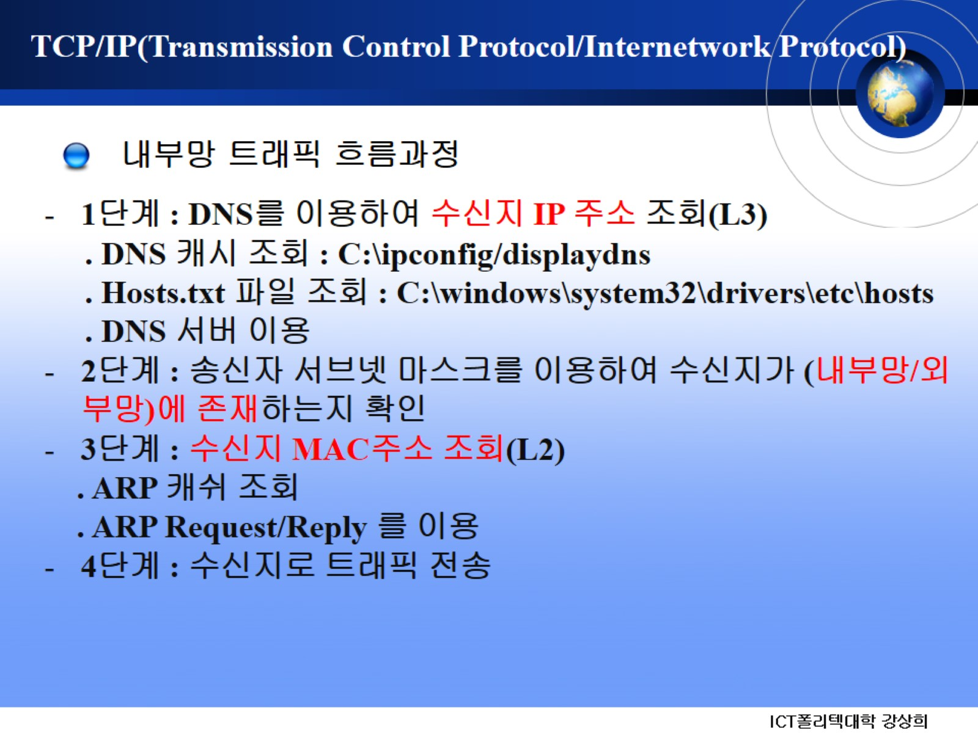
TCP/IP(Transmission Control Protocol/Internetwork Protocol)

Slide 18
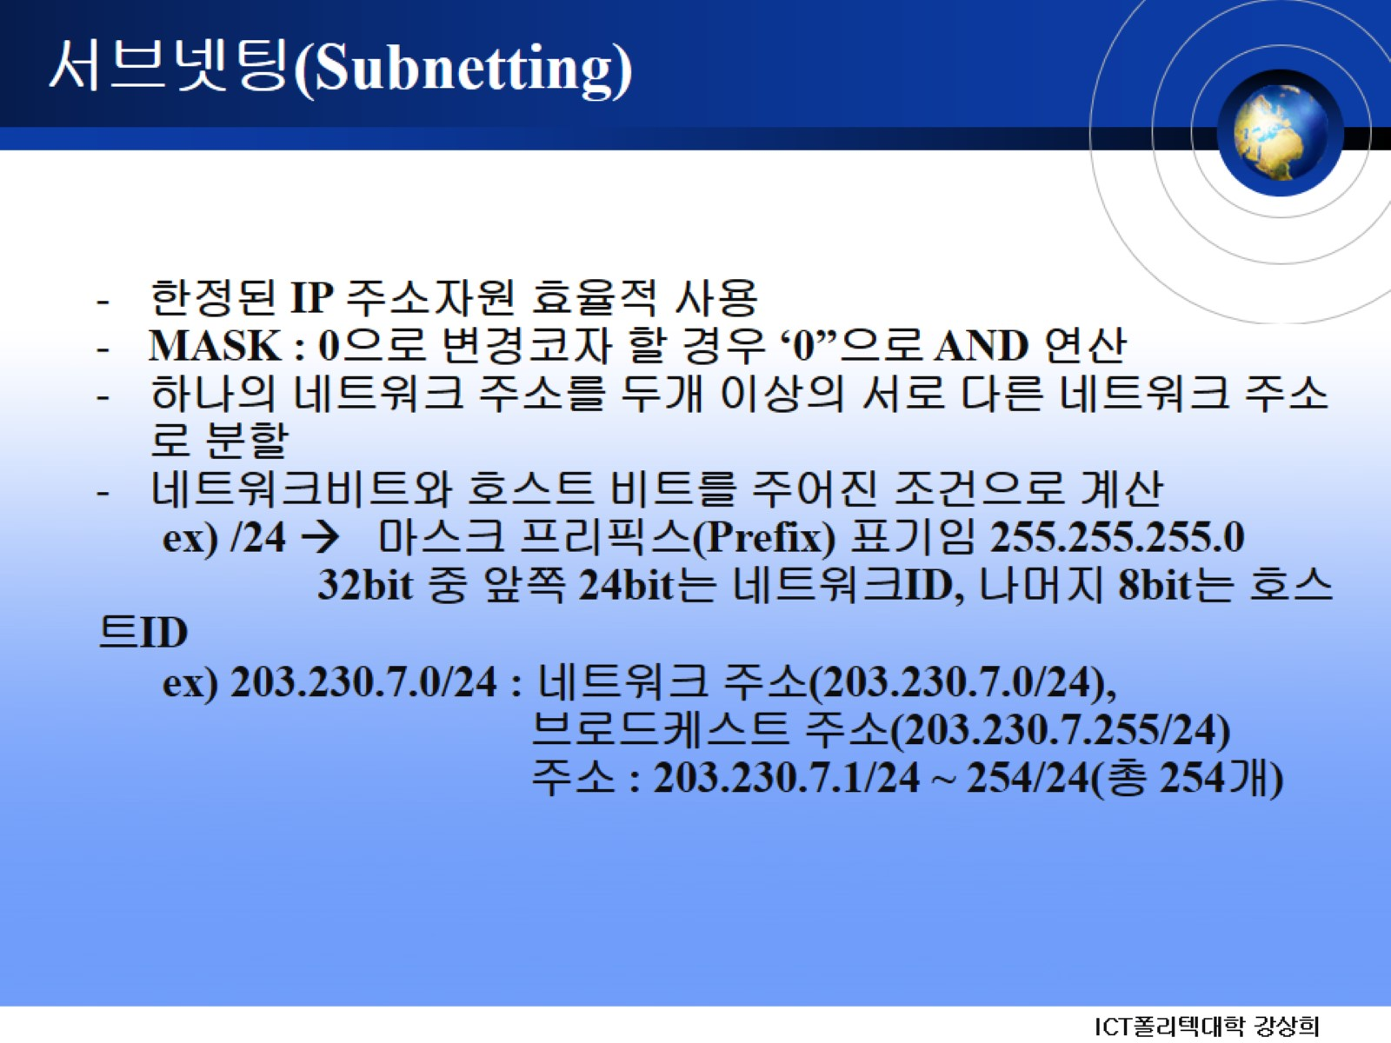
서브넷팅(Subnetting)

Slide 19
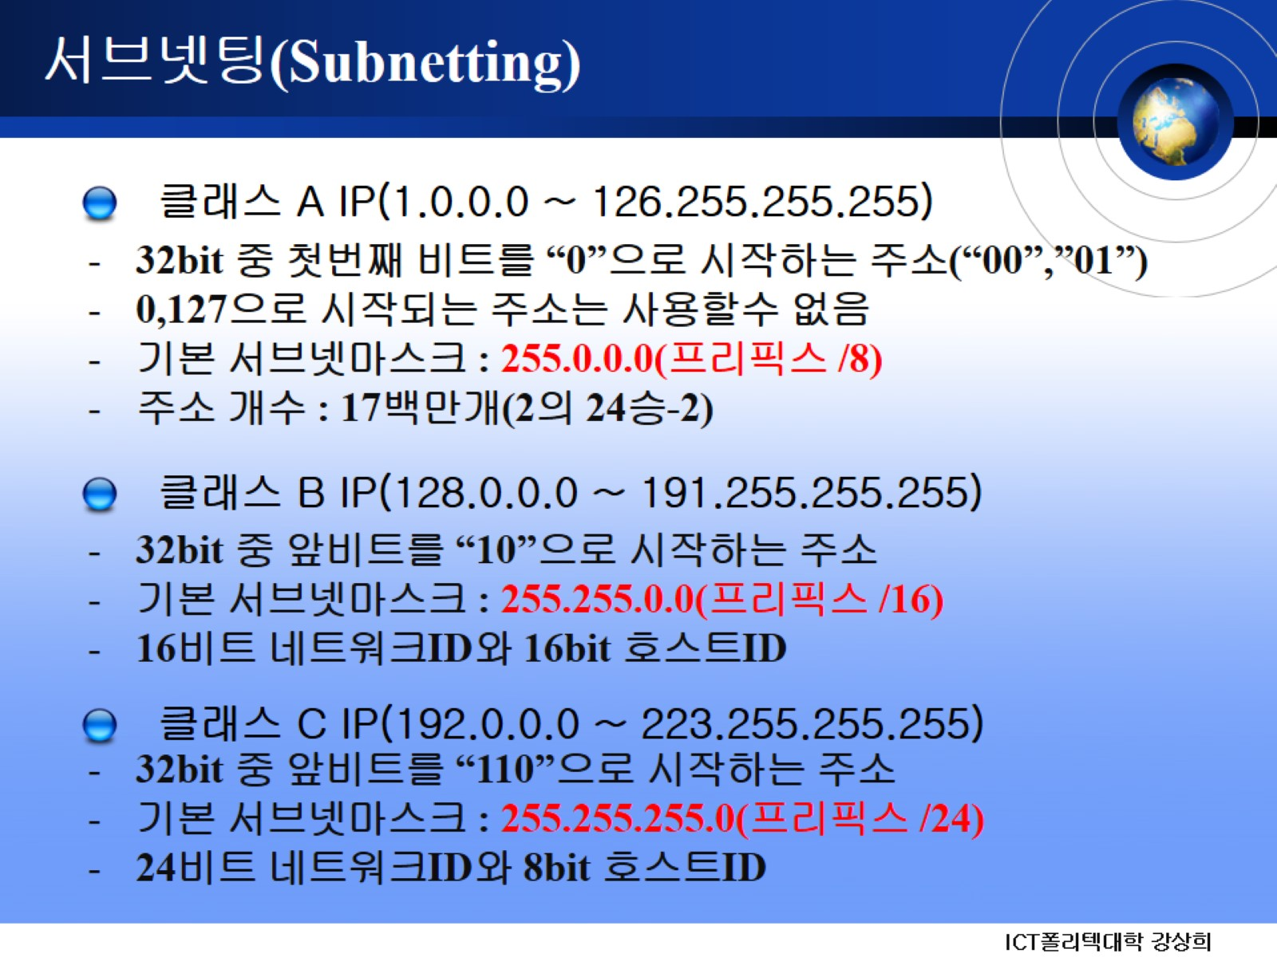
서브넷팅(Subnetting)

Slide 20
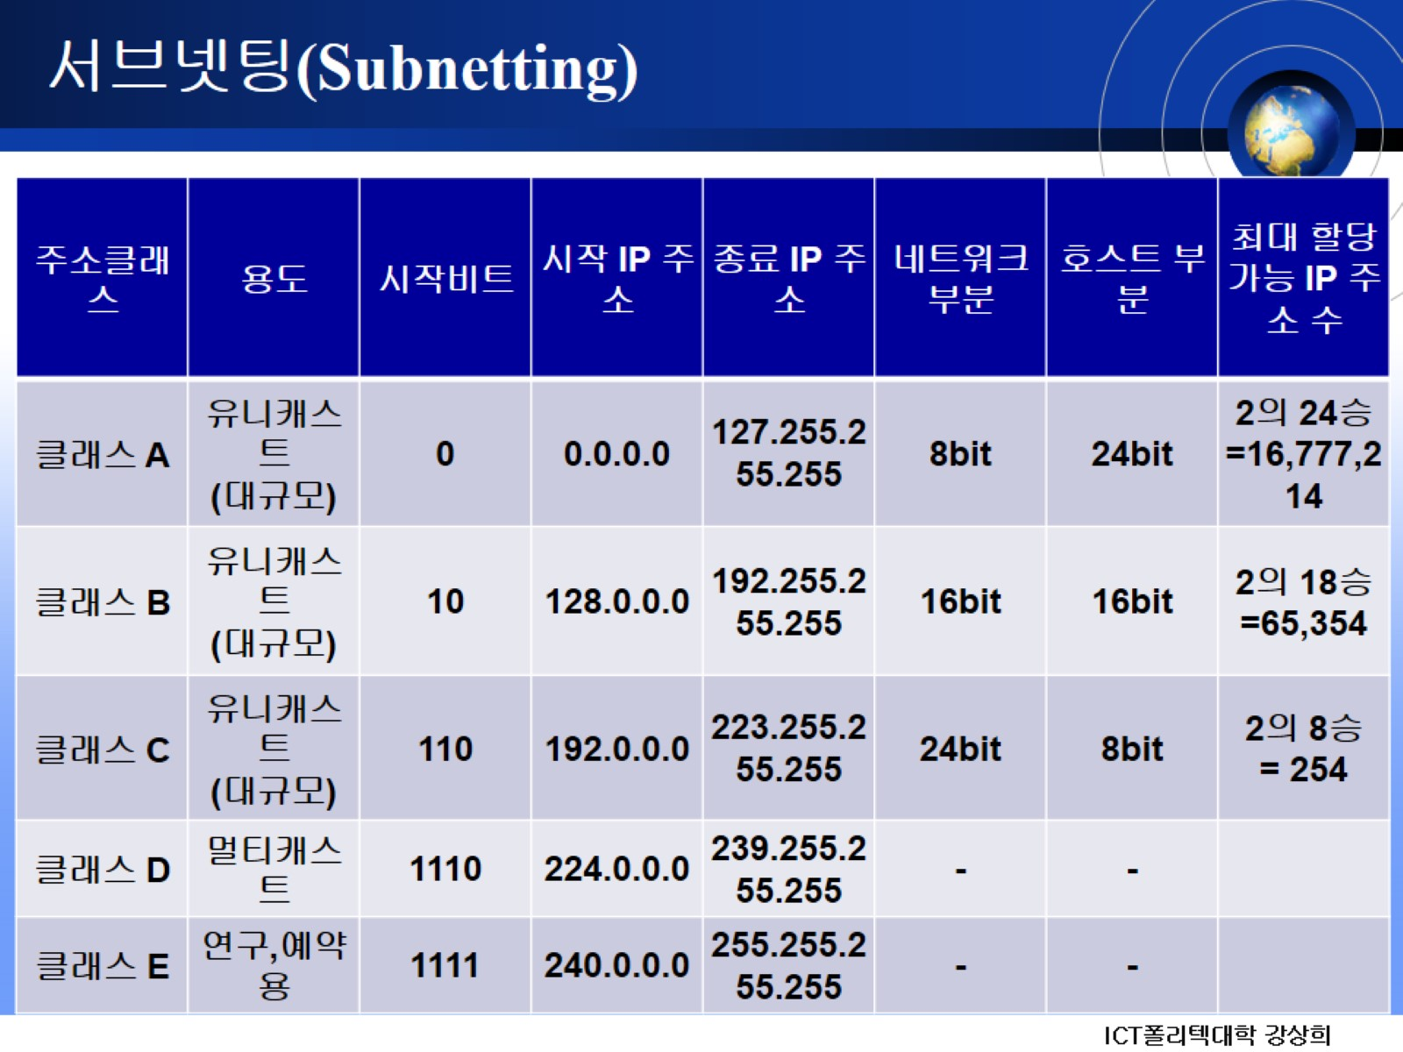
서브넷팅(Subnetting)

Slide 21
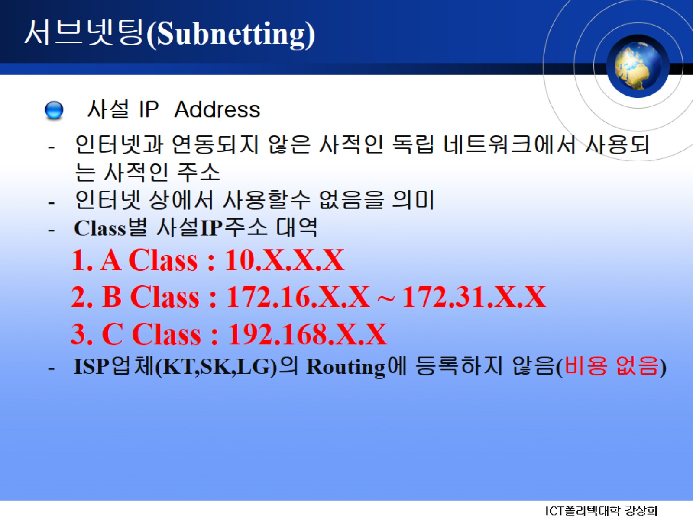
서브넷팅(Subnetting)

Slide 22
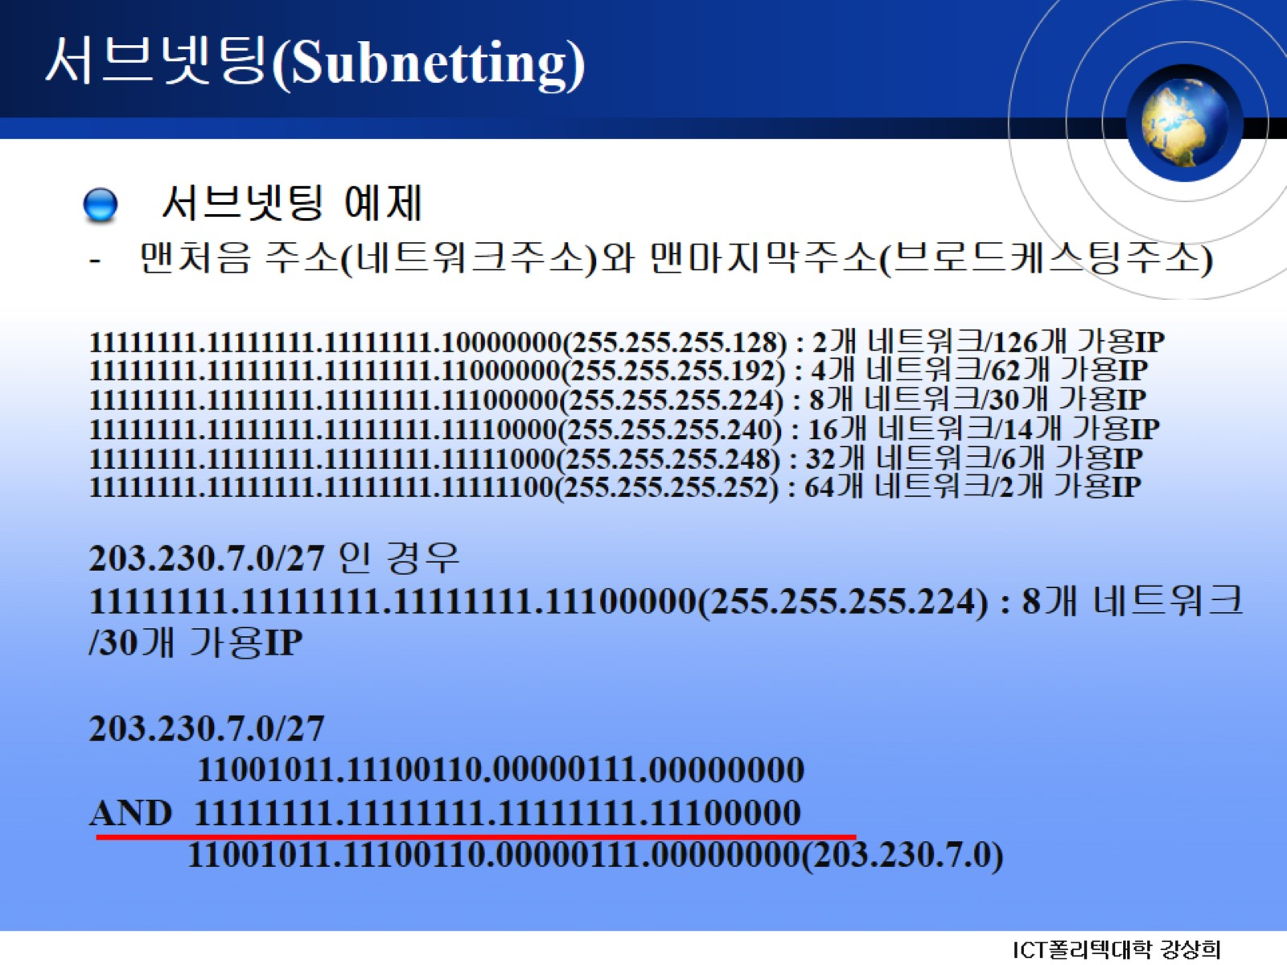
서브넷팅(Subnetting)

Slide 23
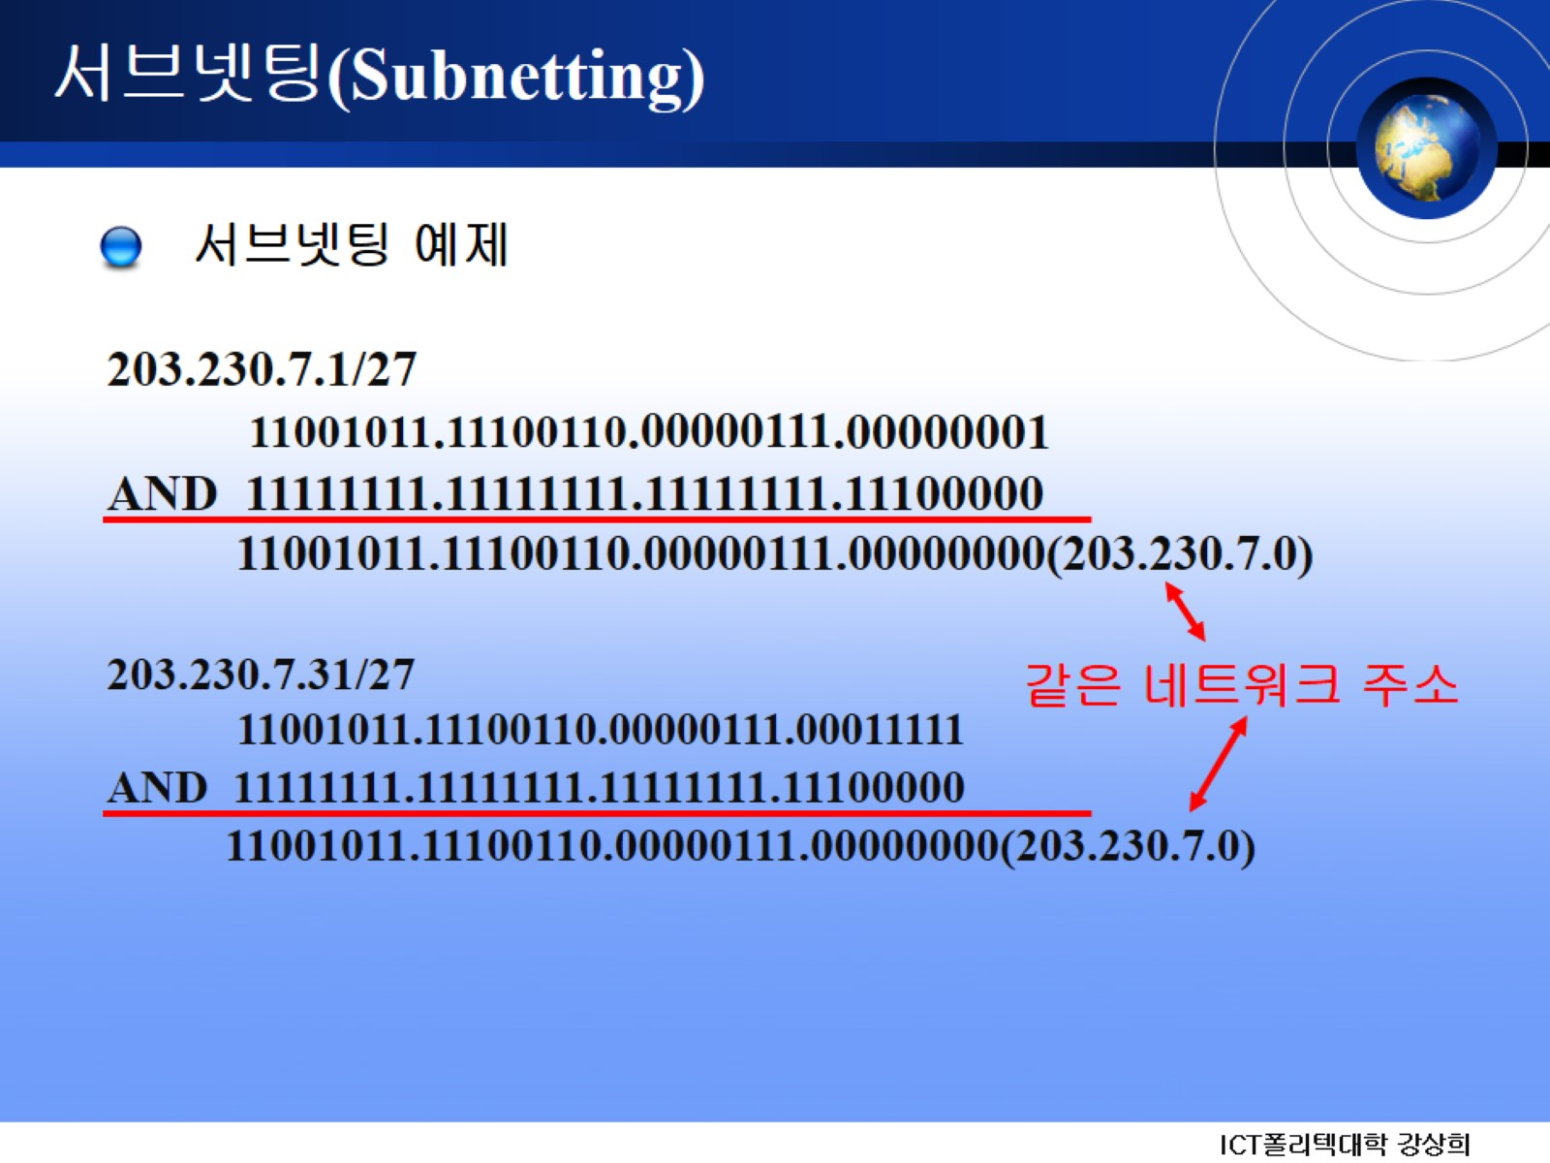
서브넷팅(Subnetting)

Slide 24
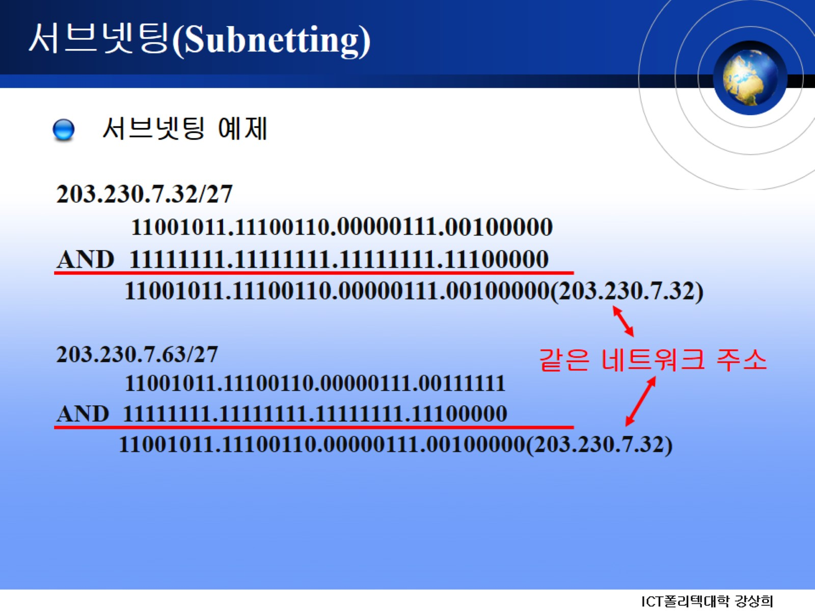
서브넷팅(Subnetting)

Slide 25

서브넷팅(Subnetting)

Slide 26

서브넷팅(Subnetting)

Slide 27
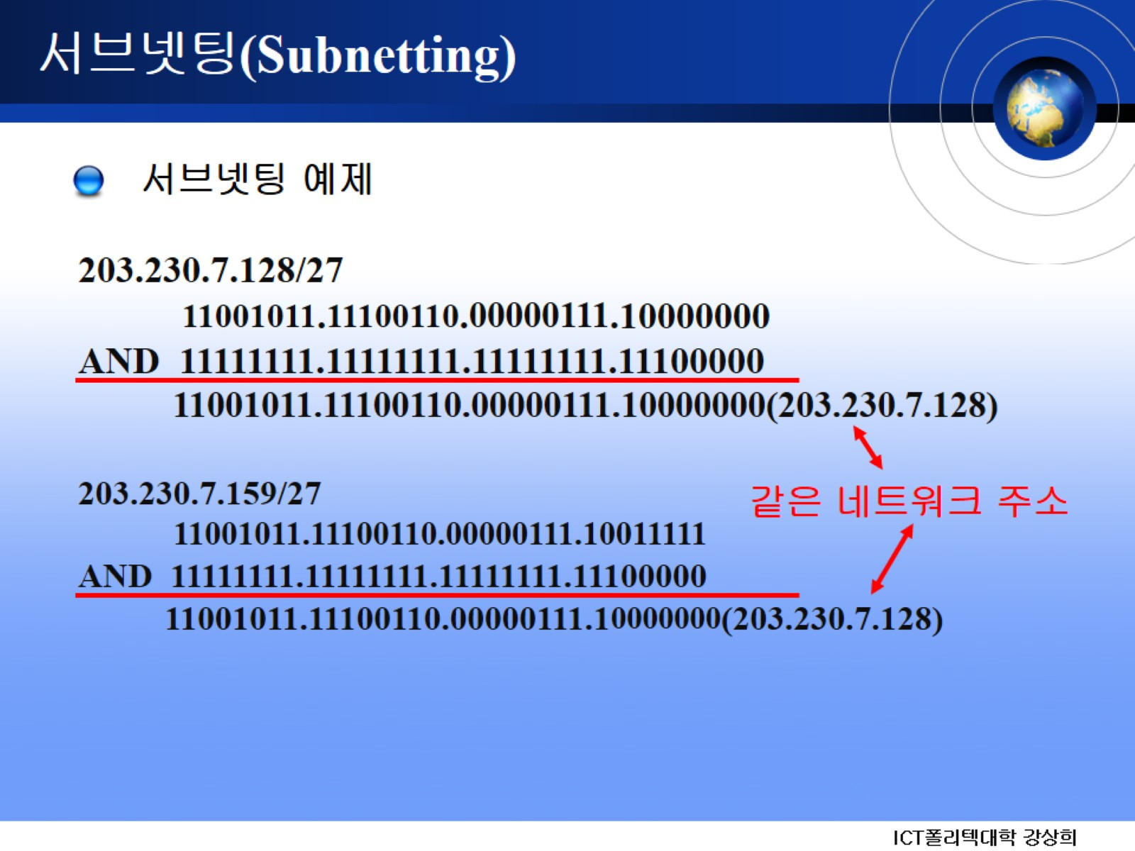
서브넷팅(Subnetting)

Slide 28
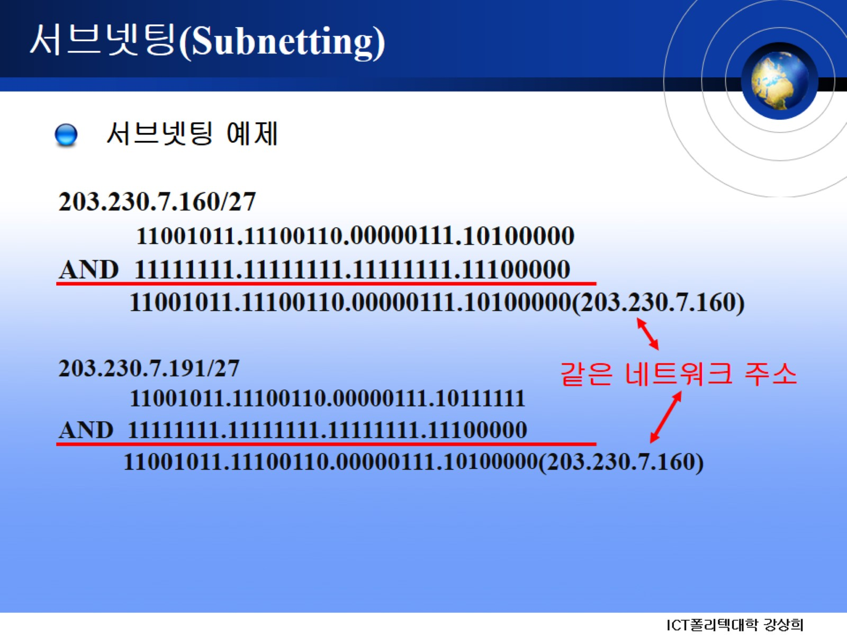
서브넷팅(Subnetting)

Slide 29

서브넷팅(Subnetting)

Slide 30

서브넷팅(Subnetting)

Slide 31
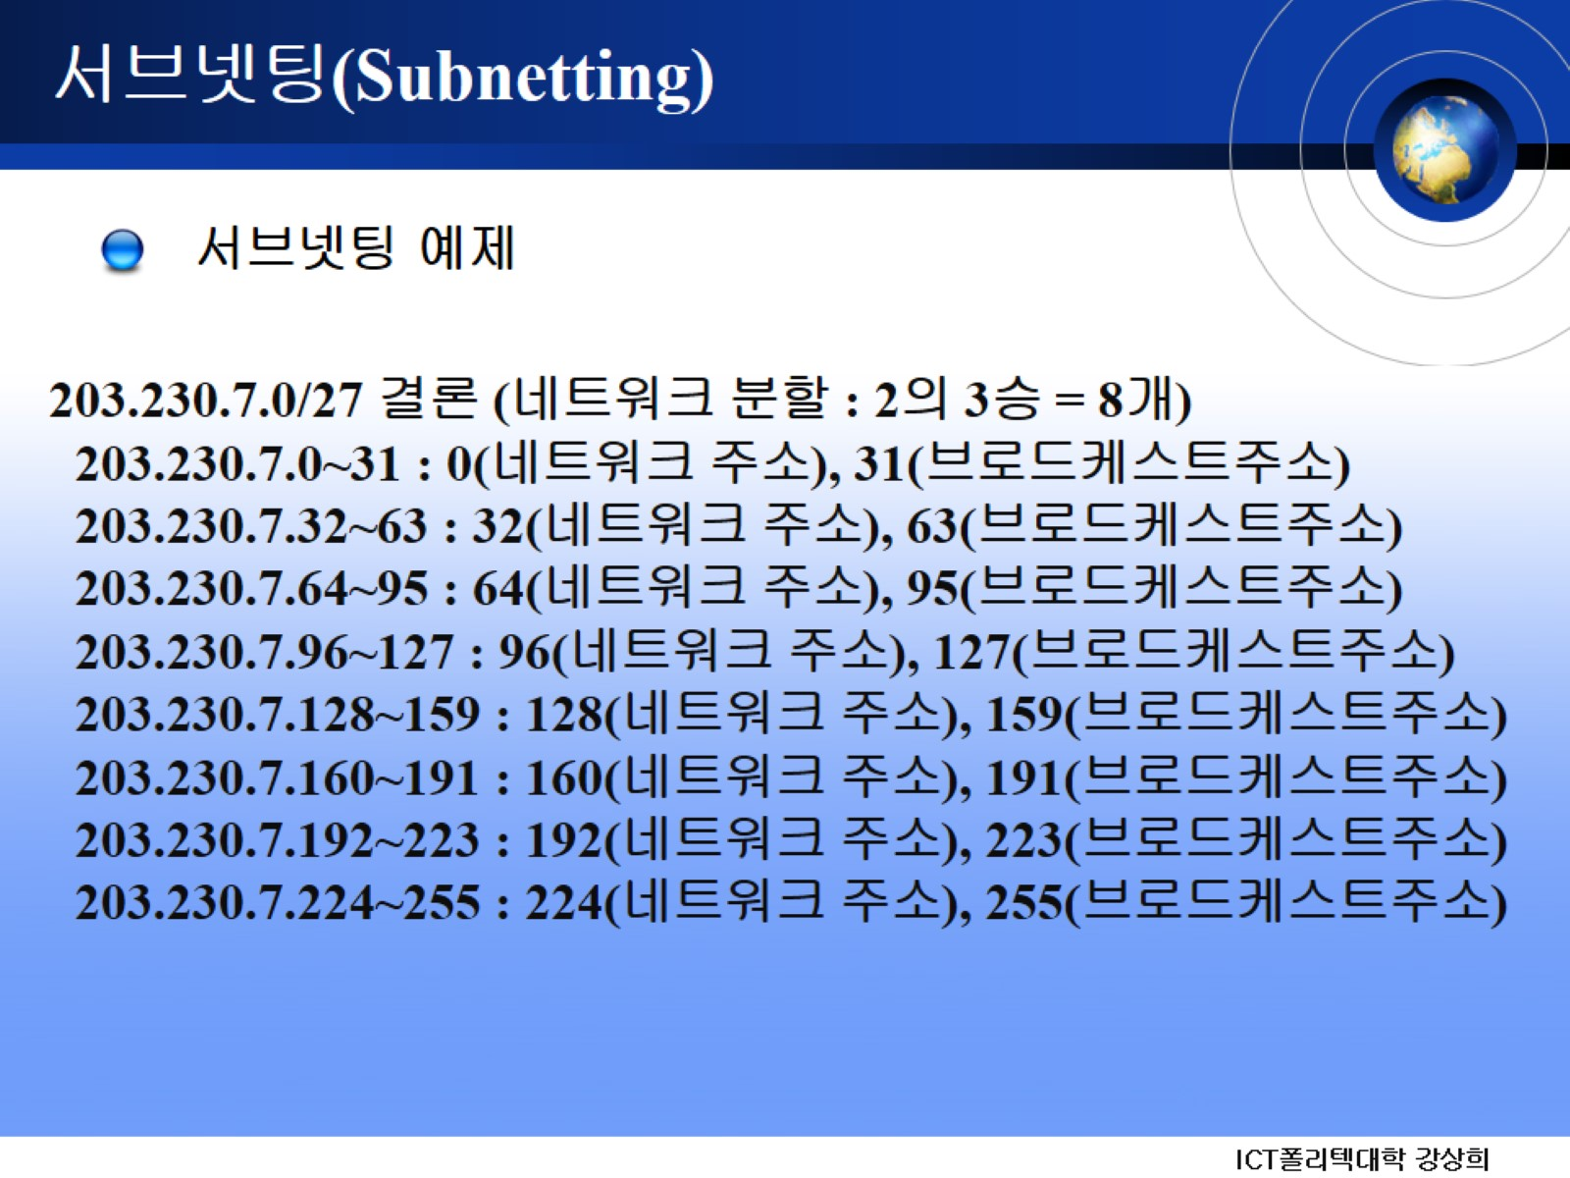
서브넷팅(Subnetting)

Slide 32
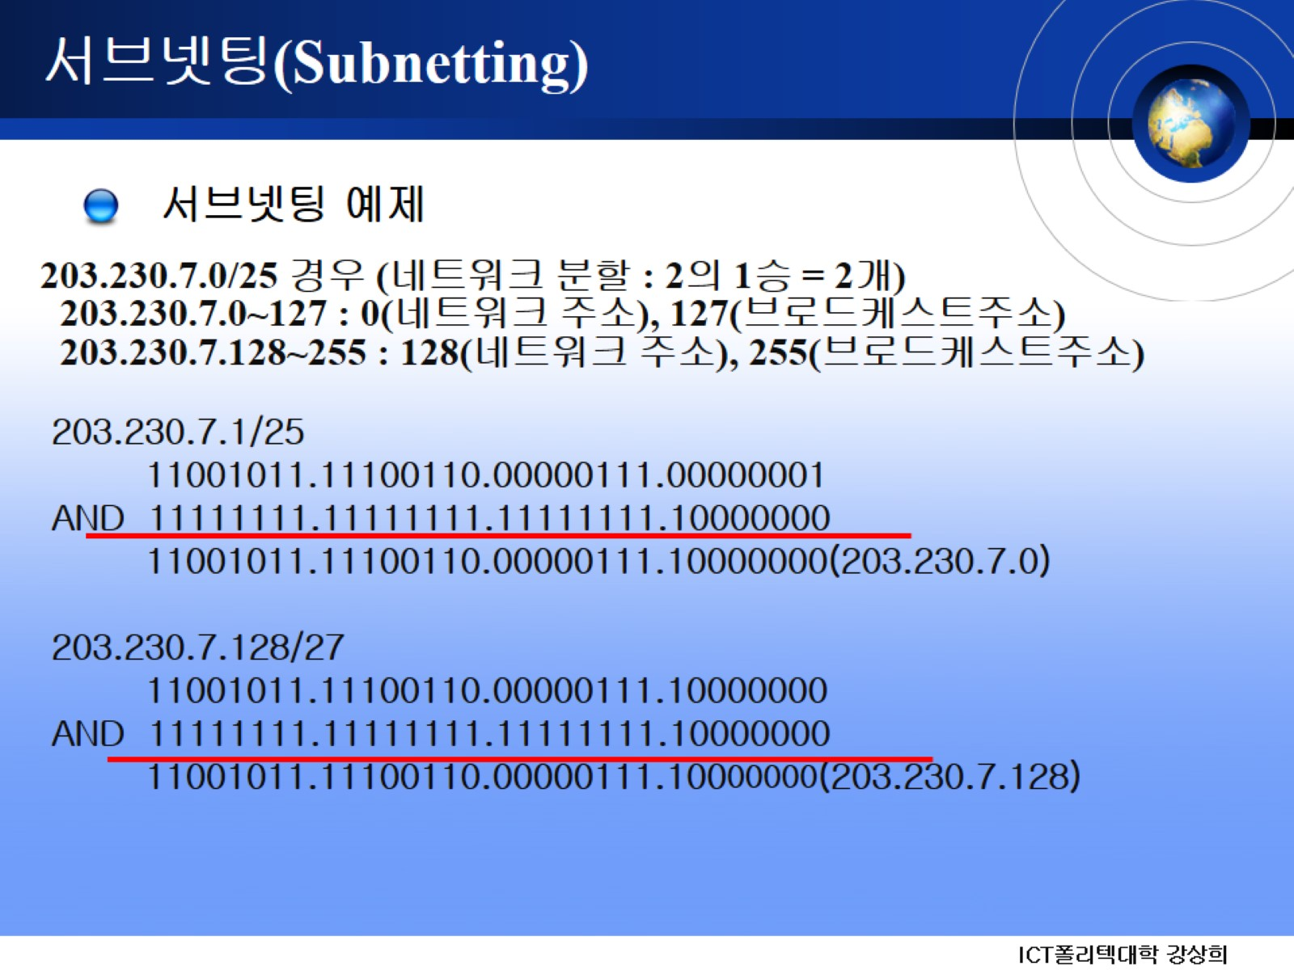
서브넷팅(Subnetting)

Slide 33
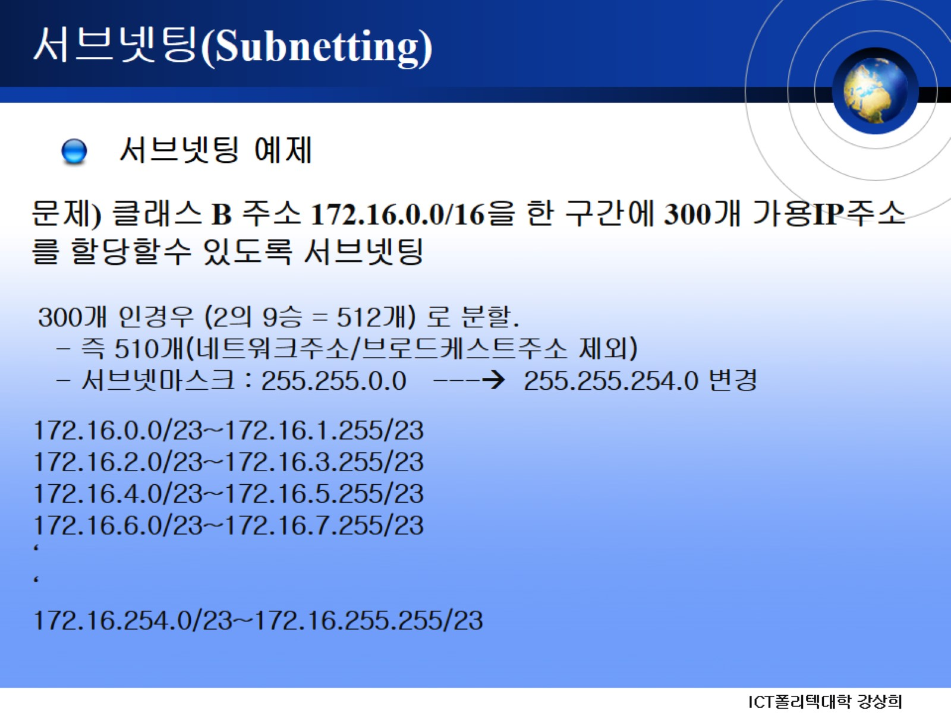
서브넷팅(Subnetting)

Slide 34
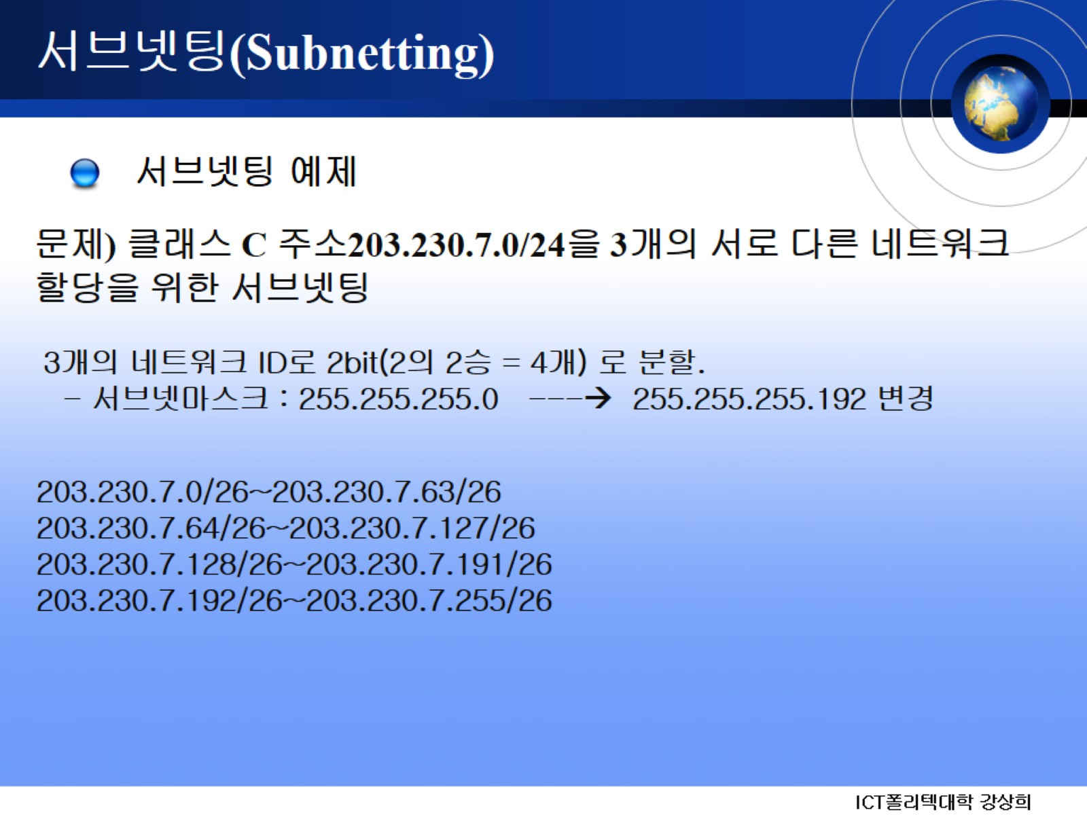
서브넷팅(Subnetting)

Slide 35
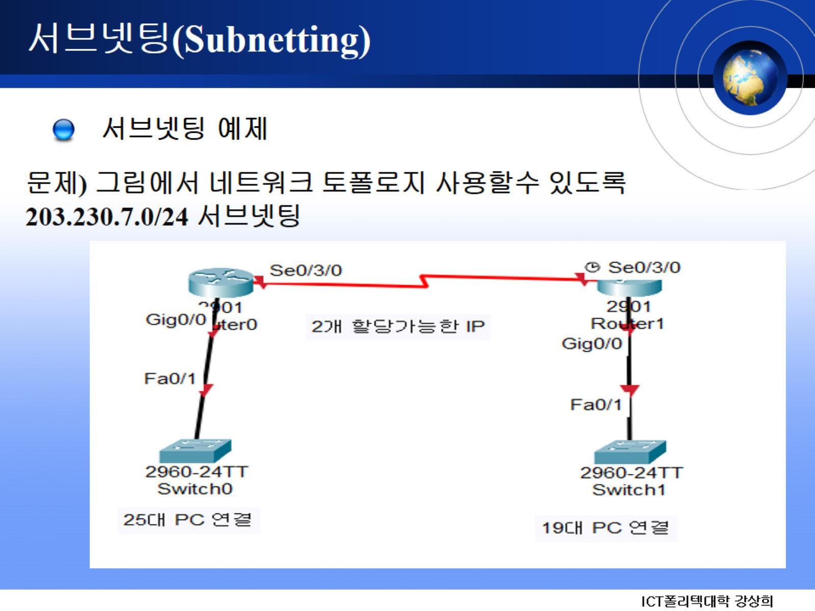
서브넷팅(Subnetting)

Slide 36
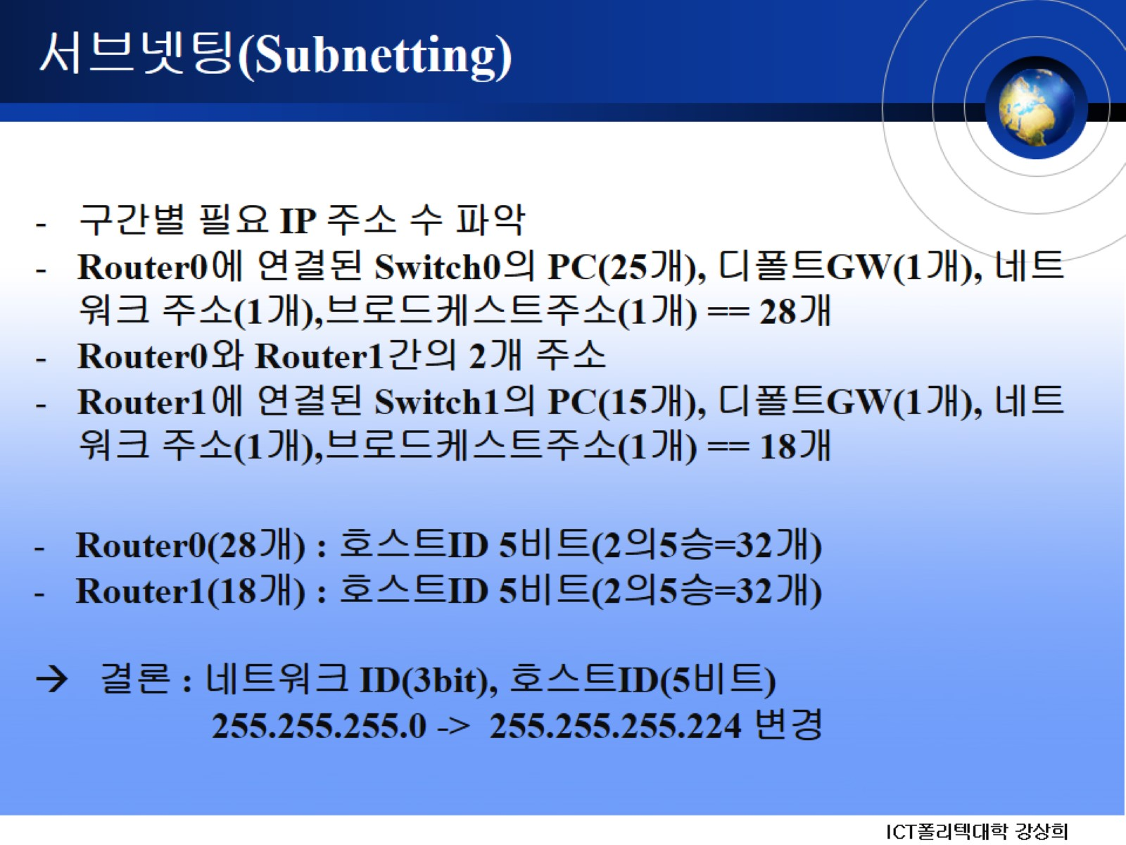
서브넷팅(Subnetting)

Slide 37
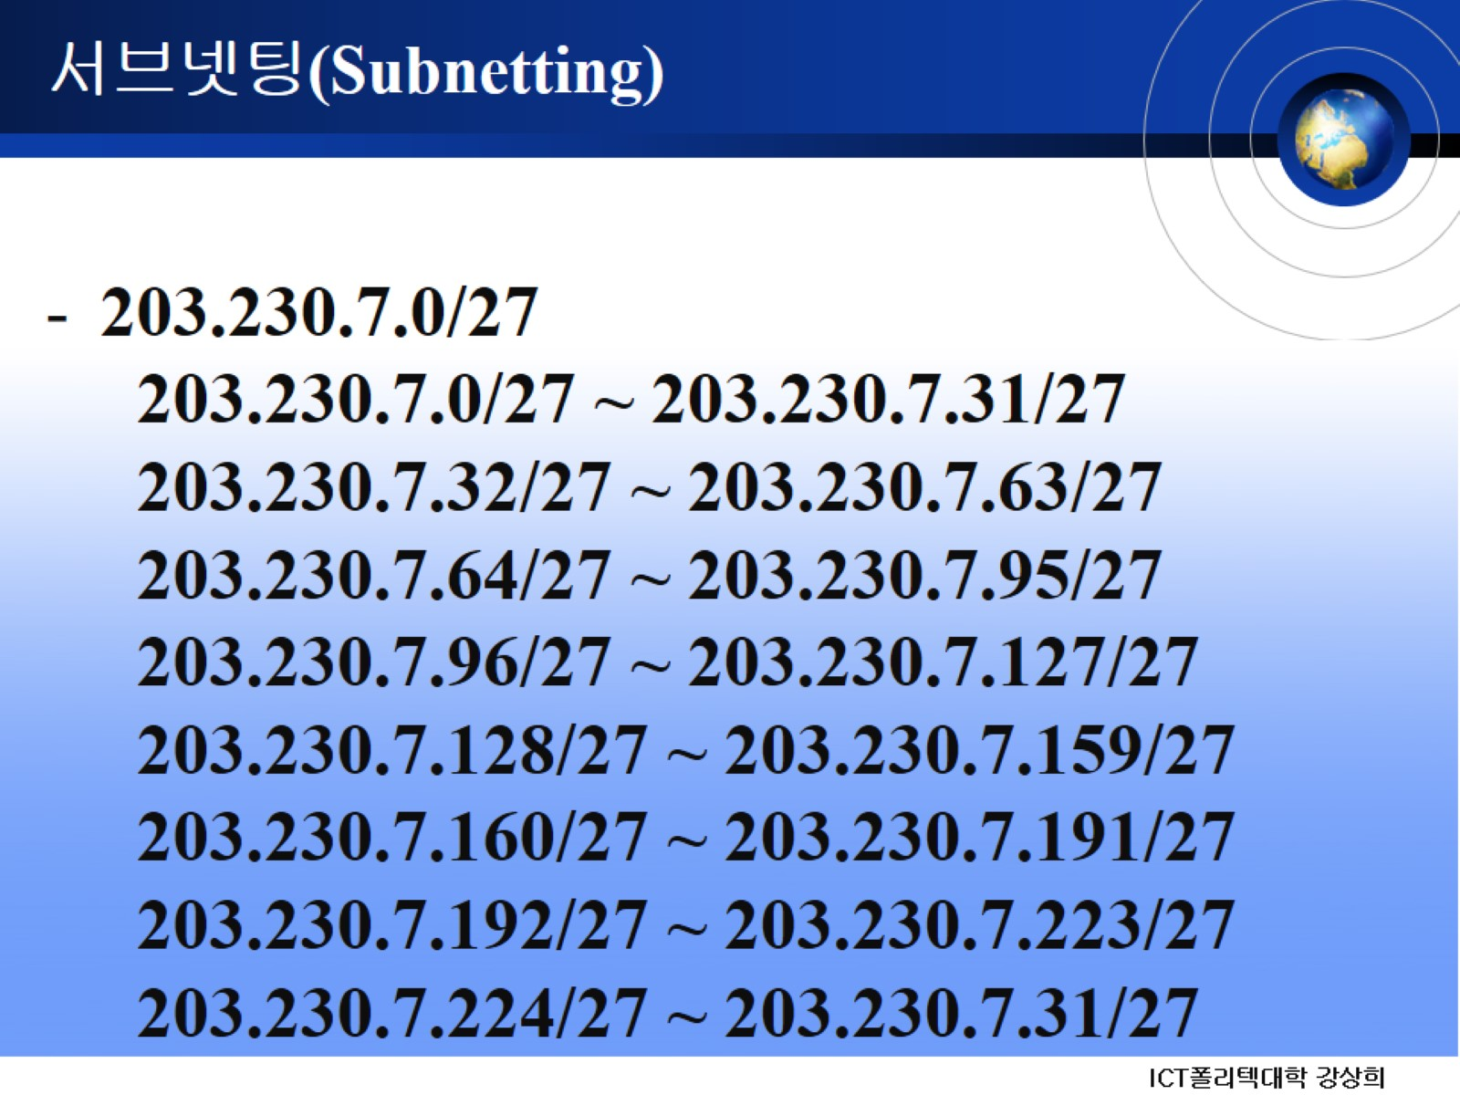
서브넷팅(Subnetting)

Slide 38
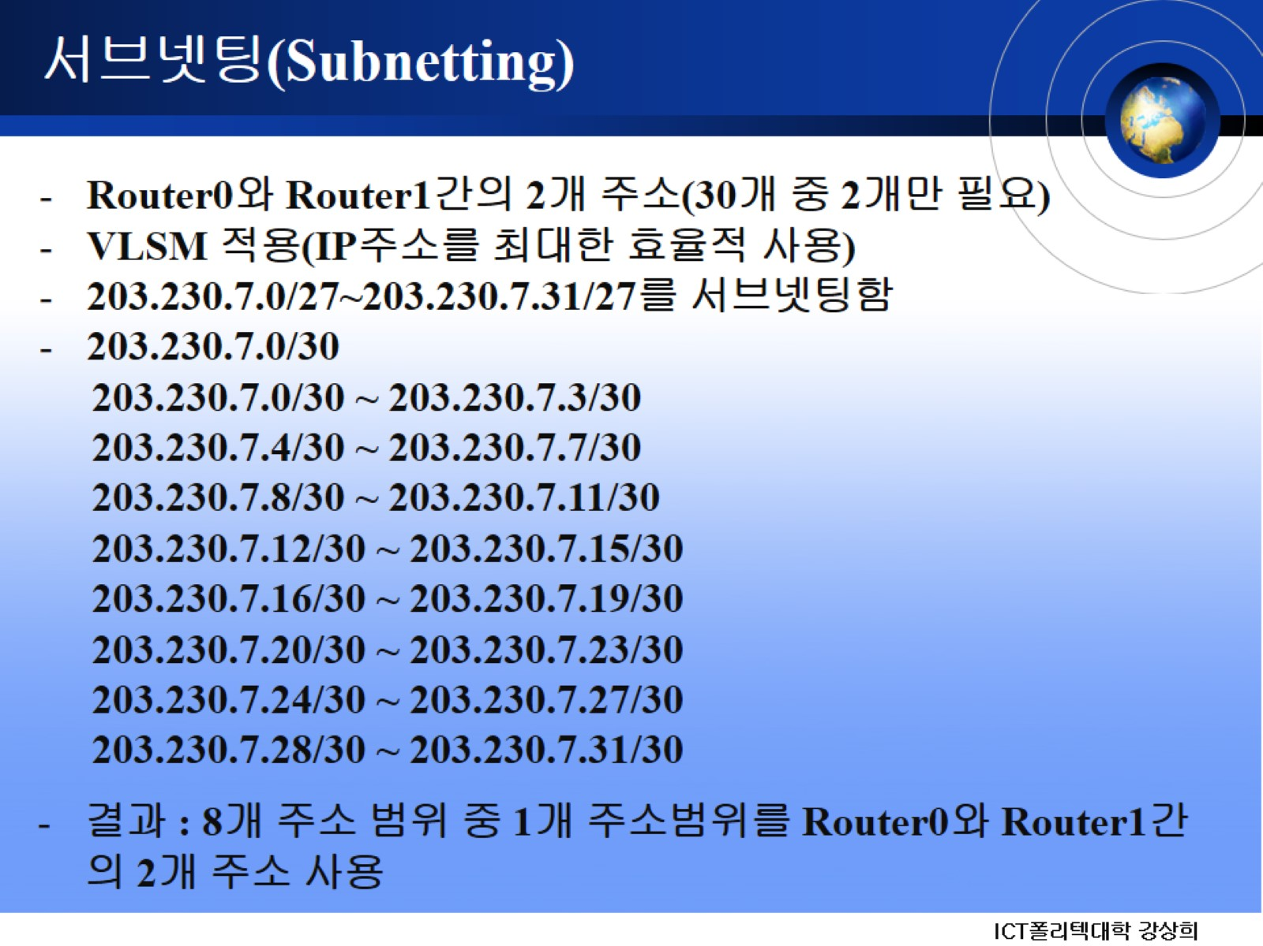
서브넷팅(Subnetting)

Slide 39

Q & A

Slide 40


